Slide 1
👋 Hello & Welcome
⏳ This session will begin shortly.
While you wait, please download the slides for today’s session from the LevUL up website.
In association with:

Slide 2
Recording
This session will now be recorded. Any further information that you provide during a session is optional and in doing so you give us consent to process this information.
These recordings will be stored by the University of Limerick for one year and may be published on our website during that time.
By taking part in a session you give us your consent to process any information you provide during it.

Slide 3
Working Together Online: Establishing a learning community, Organising and Working in Study Groups
Dr Michael Wride,
Transformative Pedagogies Lead

Slide 4
Outline
Knowing how to communicate with others is vital, especially when learning online.
In this workshop, we will discuss how to develop a learning community.
This workshop explains how you can expect to communicate with teaching staff and fellow students.
You will also learn about how to organise online study groups and why they can enrich your learning experience.
Notes:
Knowing how to communicate with others is vital, especially when learning online.
In this workshop, we will discuss how to develop a learning community.
This workshop explains how you can expect to communicate with teaching staff and fellow students.
You will also learn about how to organise online study groups and why they can enrich your learning experience.

Slide 5
Blended Teaching
Notes:
There have been many changes to the way teaching and learning are taking pace at UL. While seminars, laboratories and tutorials will be facilitated as much as possible, social distancing regulations means that large-group lectures will be delivered either partially or fully online. This combination of online lectures for larger groups and face-to-face seminars, tutorials or laboratory classes for smaller groups is called a blended model of teaching and learning.
Many of you entering for the first time or returning to UL this year may be connecting to your classes from afar and in less than ideal circumstances. As a student you might be virtually attending your classes from your kitchen table. Without the physical surroundings of the university, learning can be an isolated – and isolating- experience. However, you can still get the most out of the experience by actively engaging with your fellow students online and being part of the online community.

Slide 6
Learning is a social act
Students learn through interacting with the lecturer and with each other – to create a learning community
1.
2.
3.
4.
Notes:
Under normal circumstances, learning happens formally and informally through social interactions. During traditional face to face teaching students learn through interacting with the lecturer and with each other.
These interactions form the basis of what’s called a learning community.
Typically, these interactions fall into four key areas:
Lecturer – Student.
Student-Content.
Student-Student.
Student – Institution
These interactions are also possible online, but in different ways.

Slide 7
How will my lecturer interact with my class?
Type of Exchange | Examples of what you can expect from the lecturer
Content-related | Presenting new content and/or sharing information Asking and/or answering content-related questions Discussing ideas
Planning of tasks | Planning and allocating tasks Reviewing assignment drafts Negotiate group work challenges
Social support | Provide support or advice Talking about things other than class work
Notes:
When attending a lecture face-to-face, your lecturer would use their time with you to either talk about content, plan tasks, or provide social support. You can still expect these types of communication to happen. Some will take place in live real-time sessions with your lecturer and some will take place off-line, via email or on the virtual learning environment platforms Sulis or Moodle.
During a live session, a lecturer may present some content and then ask a question related to this material. For a tutorial, they might even organise a live class discussion on the topic where everyone can contribute ideas or opinions on the topic. Either way, keeping up with each session is important. Make sure that you save some time in advance for pre-reading or watching an assigned recording. This will help you to develop opinions and ideas that you can use in a live session, such as a tutorial, or draw from later on for an assignment.
Your course content will cover important topics that could form the bases of a group project or a topic for a discussion board. These tasks could be discussed during a live session or sent to you via email or as an announcement on Sulis or Moodle. Your lecturer may explain the expectations of the task, allocate key roles or review drafts of material that your group has already developed. Participating in these tasks will help you to engage with your lecturer and your fellow students, as well as helping you to form key ideas about the content.
Finally, your lecturers may also offer social support. This support could be through informal chats with ‘early arrivals’ to an online lecture. Lecturers may also provide virtual ‘office-hours’. If you are having trouble understanding a topic, it ask if it can be covered in your next tutorial. Remember, if you are struggling to keep up, it’s a good idea get help as soon as possible.

Slide 8
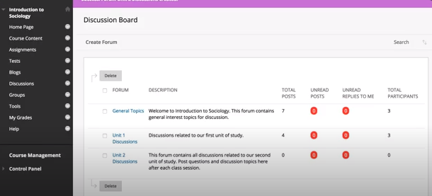
How will I be asked to learn?
Example: Discussion Forums & Chats
“The purpose of this discussion thread is for you to post thoughts and ask questions on topic X. When appropriate, please feel free to post thoughts to questions posed by others as well.”
Add a relevant post
Review other recent posts
For a live session use the chat for:
Asking questions
Commenting - Interesting ideas/opinions
Notes:
Just as in a face-to-face environment, lecturers will include a variety of ways for you to deepen your understanding of a topic. Lecturers might expect you to read journal articles, review videos or analysis data or laboratory guidelines. Such resources may be available outside of the physical lab or through your online library access.
In a normal face-to-face lecture, you might be asked to chat to a friend about a concept or question. In blended learning, this might take place on a discussion board as you can see on this slide. Posting on a discussion board is a great way for you to check your understanding of a topic, interact with your classmates and have a record of discussions on a topic for future study sessions.
Discussions boards can inspire conversations in a live sessions. For a live session, you might be asked to comment on something that you read or ask a question. You might then be set follow-on tasks to strengthen your learning– either on your own or with others.

Slide 9
How will I be asked to work with others?
Offline group activities
Blogs
Wikis
Discussion boards
Group projects
Live group activities
Presentations
Discussions
What is your experience of learning with others?
What are some of the advantages?
What are some of the challenges?
Post in the chat or come on the mic.
Notes:
In a face-to-face lecture you might be asked to work closely with the person sitting beside you, but engaging with your class does not happen as naturally online. Instead, you can work collaboratively online with your fellow students using tools like discussion boards, blogs, and wikis.
Live sessions will be scheduled online using Big Blue Button in Sulis or through Teams. These sessions can be used for group projects such as presentations, as well as live discussions or webinars. In a live session, remember the visual cues that we rely on in a lecture or tutorial are missing. To get the most out of your live sessions with your fellow students and understand how to communicate with others online. You might benefit from attending the Netiquette workshop to help you.

Slide 10
Giving feedback
Be respectful, remember that everybody’s contribution is valid.
If asked to provide feedback
Read the entire document before giving the feedback
Highlight strengths
Offer constructive suggestions
Keep your comments clear and relevant
Notes:
Giving and receiving feedback is a crucial part of learning. If you’re asked to give feedback to your fellow students, remember that everyone’s opinions or contributions are valid and will result in a richer, more informed discussion on a topic.
As part of a peer learning task, you might be asked to review a fellow student’s work. This might happen through a conversation online, or as written feedback on a piece of work. If you are asked to provide feedback, remember to read the document from start to finish before you comment.
Highlight pieces that you really like or address the topic well. This helps to clarify thoughts that your fellow student might have on the assignment.
Suggest areas of improvement. Try to make useful or helpful suggestions that they can take away.
Finally, make sure that your comments are clear and relevant to the piece.

Slide 11
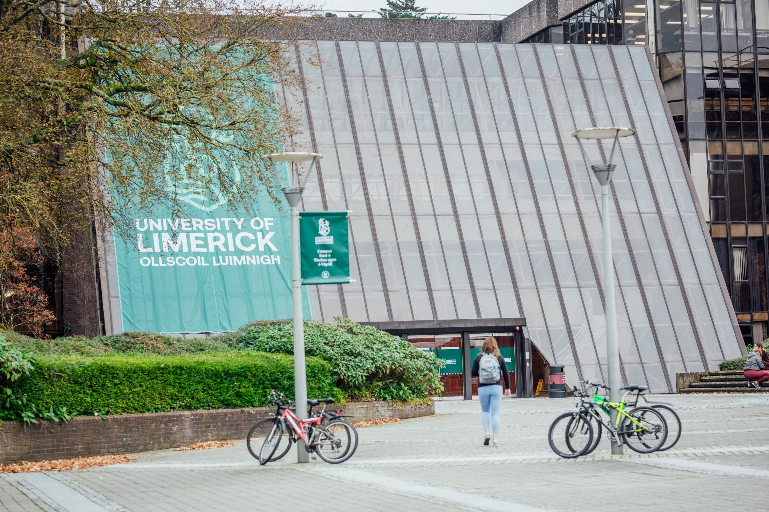
Engaging with UL
Feeling connected to the UL community and being aware that ‘we’re all in this together’ can go a long way to help decrease the frustrations of learning remotely.
You might also find it beneficial to share your own frustrations as well as positive experiences about learning online with your fellow students.
Frustrations?
Positive experiences?
Post in the chat or come on the mic.
Notes:
All lecturers value their teaching time and time with you the students immensely. We realize that this move to blended teaching and learning is challenging for both students and for staff. We want you to know that you are not alone if you feel frustrated with this situation sometimes.
Feeling connected to the UL community and being aware that ‘we’re all in this together’ can go a long way to help decrease the frustrations. You might also find it beneficial to share your own frustrations as well as positive experiences about learning online with your fellow students. You can do this with your classmates by participating in class learning and with other students by joining a club or society.

Slide 12
Organising and Working in Study Groups
Study groups can enable you to:
Discuss your views about the course and listen to other insights and understandings.
Discuss learning approaches and strategies which can deepen your learning.
Provides opportunities to explain and get feedback on concepts and ideas.
Gives the opportunity to practice important teamwork skills.
Helps avoid procrastination.
Helps you stay motivated
Notes:
Study groups can enable you to:
Discuss your views about the course and listen to other insights and understandings.
Discuss learning approaches and strategies which can deepen your learning.
Provides opportunities to explain and get feedback on concepts and ideas.
Gives the opportunity to practice important teamwork skills.
Helps avoid procrastination.
Helps you stay motivated

Slide 13
Online study groups
Groups of 3-4 students is a good size.
Groups of students from the same course focus learning.
And/or work with students from different courses to provide different perspectives Choose a virtual meeting place that is accessible to all members.
Agree on a schedule.
Decide on an agenda in advance of each meeting.
Notes:
Online study groups can work just as well as groups that meet in person. They can help you to feel less isolated by staying connected to your classmates. They can also keep you up to date with your independent learning, all from the comfort of your favourite study space.

Slide 14
In your online study group, you can
Compare lecture notes or handouts as guides for discussion topics.
Discuss concepts and brainstorm assignment ideas.
Ask questions and compare notes.
Share reading - divide, summarise, then discuss.
Create summary sheets or mind maps for future study aids.
Work through set problems.
Get feedback on practice runs of presentations.
Compare feedback received from tutor/lecturer on assignments.
Revise and answer past exam questions. Create practice exams for each other
Notes:
In your online study group, you can
Compare lecture notes or handouts as guides for discussion topics.
Discuss concepts and brainstorm assignment ideas.
Ask questions and compare notes.
Share reading - divide, summarise, then discuss.
Create summary sheets or mind maps for future study aids.
Work through set problems.
Get feedback on practice runs of presentations.
Compare feedback received from tutor/lecturer on assignments.
Revise and answer past exam questions. Create practice exams for each other

Slide 15
Guidelines for successful study groups
Take time to organise and define expectations.
Use agendas and have a leader.
Ensure group members come prepared with notes and discussion points.
Listen, pay attention and try to understand viewpoints.
Deal with any concerns early to avoid frustrations.
If the group is not working, adapt, seek help or consider dropping it.
Remember, study groups may not suit all learning styles.
Notes:
Guidelines for successful study groups
Take time to organise and define expectations.
Use agendas and have a leader.
Ensure group members come prepared with notes and discussion points.
Listen, pay attention and try to understand viewpoints.
Deal with any concerns early to avoid frustrations.
If the group is not working, adapt, seek help or consider dropping it.
Remember, study groups may not suit all learning styles.

Slide 16
Recap & Summary
Knowing how to communicate with others when learning online.
how to develop a learning community.
how you can expect to communicate with teaching staff and fellow students.
how to organise online study groups and why they can enrich your learning experience.
Notes:
Knowing how to communicate with others is vital, especially when learning online.
In this workshop, we will discuss how to develop a learning community.
This workshop explains how you can expect to communicate with teaching staff and fellow students.
You will also learn about how to organise online study groups and why they can enrich your learning experience.

Slide 17
Where from here?
This Photo by Unknown Author is licensed under CC BY-SA

Slide 18
Support & Resources
https://www.ul.ie/ctl/workshop-working-together-online-establishing-learning-community-organising-and-working-study-groups

Slide 19
Thank you
ul.ie

Slide 21
This work is licensed under a Creative Commons Attribution-NonCommercial 4.0 International (CC BY-NC 4.0)

